Slide 1
Algorithms
Lecture 5
Max Sum Subarray (Divide and Conquer)
Lecturer
Department of Computer Science and Engineering
BRAC University

Slide 2
Maximum Subarray Problem
Input: an array A[1..n] of n numbers
Assume that some of the numbers are negative, because this problem is trivial when all numbers are nonnegative
Output: a nonempty subarray A[i..j] having the largest sum S[i, j] = a_{i} + a_{i+1} +... + a_{j}
1 2 3 4 5 6 7 8 9 10 11 12 13 14 15 16
A
13 | -3 | -25 | 20 | -3 | -16 | -23 | 18 | 20 | -7 | 12 | -5 | -22 | 15 | -4 | 7
maximum subarray

Slide 3
Maximum Subarray Problem
Target array :
1
-4
3
2
What is a maximum subarray?
All the sub arrays:
1
1
-4
-4
Ans: The subarray with the largest sum
3
3
2
2
1
-4
-3
What is the brute-force time?
-4
3
-1
Max!
3
2
5
1
-4
3
0
-4
3
2
1
1
-4
3
2
2

Slide 4
Brute-Force Algorithm
All possible contiguous subarrays
A[1..1], A[1..2], A[1..3], ..., A[1..(n-1)], A[1..n]
A[2..2], A[2..3], ..., A[2..(n-1)], A[2..n]
...
A[(n-1)..(n-1)], A[(n-1)..n]
A[n..n]
How many of them in total?
Algorithm: For each subarray, compute the sum.
Find the subarray that has the maximum sum.
O(n²)

Slide 5
Brute-Force Algorithm
Example: 2 -6 -1 3 -1 2 -2
sum from A[1]: 2 -4 -5 -2 -3 -1 -3
sum from A[2]: -6 -7 -4 -5 -3 -5
sum from A[3]: -1 2 1 3 1
sum from A[4]: 3 2 4 2
sum from A[5]: -1 1 -1
sum from A[6]: 2 0
sum from A[7]: -2

Slide 6
Brute-Force Algorithm
Outer loop: index variable i to indicate start of subarray, for 1 ≤ i ≤ n, i.e., A[1], A[2], ..., A[n]
for i = 1 to n do ...
Inner loop: for each start index i, we need to go through A[i..i], A[i..(i+1)], ..., A[i..n]
use an index j for i ≤ j ≤ n, i.e., consider A[i..j]
for j = i to n do ...

Slide 7
Brute-Force Algorithm
max = -∞
for i = 1 to n do
begin
sum = 0
for j = i to n do
begin
sum = sum + A[j]
if sum > max
then max = sum
end
end
Time complexity?
O(n²)

Slide 8

Divide-and-Conquer Algorithm
Possible locations of a maximum subarray A[i..j] of A[low..high], where mid = ⎣(low + high)/2⎦
entirely in A[low..mid] (low ≤ i ≤ j ≤ mid)
entirely in A[mid+1..high] (mid < i ≤ j ≤ high)
crossing the midpoint (low ≤ i ≤ mid < j ≤ high)
crossing the midpoint
low mid high
entirely in A[low..mid]
entirely in A[mid+1..high]
Possible locations of subarrays of A[low..high]

Slide 9
Divide-and-Conquer Algorithm
FIND-MAX-CROSSING-SUBARRAY (A, low, mid, high)
left-sum = -∞ // Find a maximum subarray of the form A[i..mid]
sum = 0
for i = mid downto low
sum = sum + A[i ]
if sum > left-sum
left-sum = sum
max-left = i
right-sum = -∞ // Find a maximum subarray of the form A[mid + 1 .. j ]
sum =0
for j = mid +1 to high
sum = sum + A[j]
if sum > right-sum
right-sum = sum
max-right = j
// Return the indices and the sum of the two subarrays
return (max-left, max-right, left-sum + right-sum)

Slide 10
Divide-and-Conquer Algorithm
A[mid+1..j]
i
low mid high
mid +1
j
A[i..mid]
A[i..j] comprises two subarrays A[i..mid] and A[mid+1..j]

Slide 11
Divide-and-Conquer Algorithm
mid =5
1 | 2 | 3 | 4 | 5 | 6 | 7 | 8 | 9 | 10
13 | -3 | -25 | 20 | -3 | -16 | -23 | 18 | 20 | -7
A
S[5 .. 5] = -3
S[4 .. 5] = 17 ⇐ (max-left = 4)
S[3 .. 5] = -8
S[2 .. 5] = -11
S[1 .. 5] = 2
mid =5
1 | 2 | 3 | 4 | 5 | 6 | 7 | 8 | 9 | 10
13 | -3 | -25 | 20 | -3 | -16 | -23 | 18 | 20 | -7
A
S[6 .. 6] = -16
S[6 .. 7] = -39
S[6 .. 8] = -21
S[6 .. 9] = (max-right = 9) ⇒ - 1
S[6..10] = -8
⇒ maximum subarray crossing mid is S[4..9] = 16

Slide 12
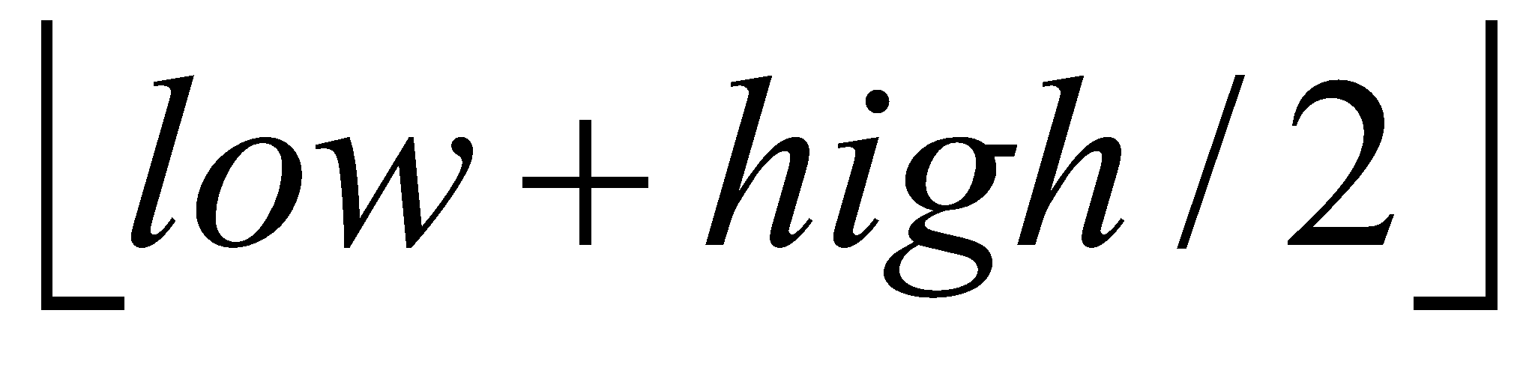
Divide-and-Conquer Algorithm
FIND-MAXIMUM-SUBARRAY (A, low, high)
if high == low
return (low, high, A[low]) // base case: only one element
else mid =
(left-low, left-high, left-sum) =
FIND-MAXIMUM-SUBARRAY(A, low, mid)
(right-low, right-high, right-sum) =
FIND-MAXIMUM-SUBARRAY(A, mid + 1, high)
(cross-low, cross-high, cross-sum) =
FIND-MAX-CROSSING-SUBARRAY(A, low, mid, high)
if left-sum ≧ right-sum and left-sum ≧ cross-sum
return (left-low, left-high, left-sum)
elseif right-sum ≧ left-sum and right-sum ≧ cross-sum
return (right-low, right-high, right-sum)
else return (cross-low, cross-high, cross-sum)
Initial call: FIND-MAXIMUM-SUBARRAY (A, 1, n)

Slide 13
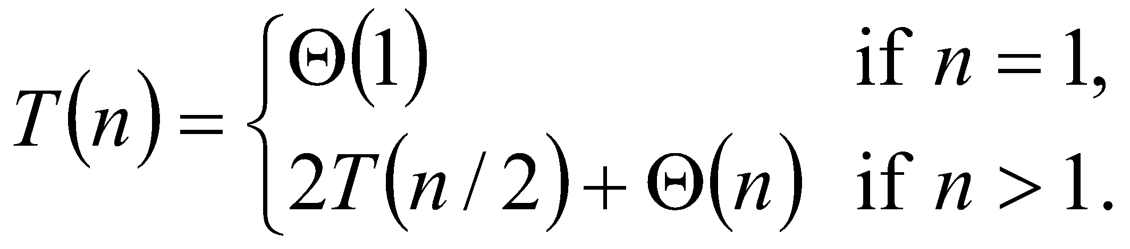
Divide-and-Conquer Algorithm
Analyzing time complexity
FIND-MAX-CROSSING-SUBARRAY : Θ(n), where n = high − low + 1
FIND-MAXIMUM-SUBARRAY
T(n) = 2T(n/2) + Θ(n)
= Θ(n lg n) (similar to merge-sort)

Slide 14
Practice
-2 | 1 | -3 | 4 | -1 | 2 | 1 | -5 | 4

Slide 15
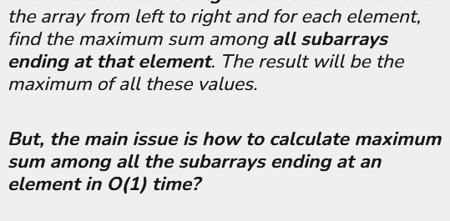
Can we do better?

Slide 16
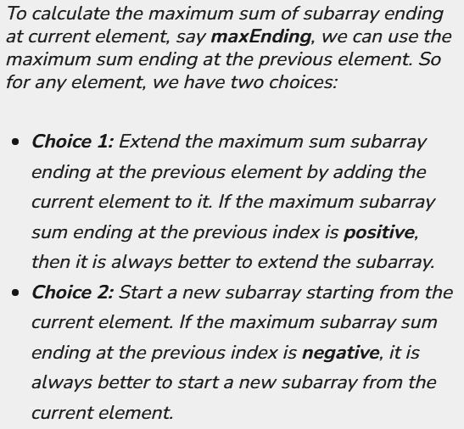
Can we do better?

Slide 17
Can we do better?

Slide 18
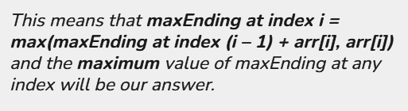
Can we do better?

Slide 19
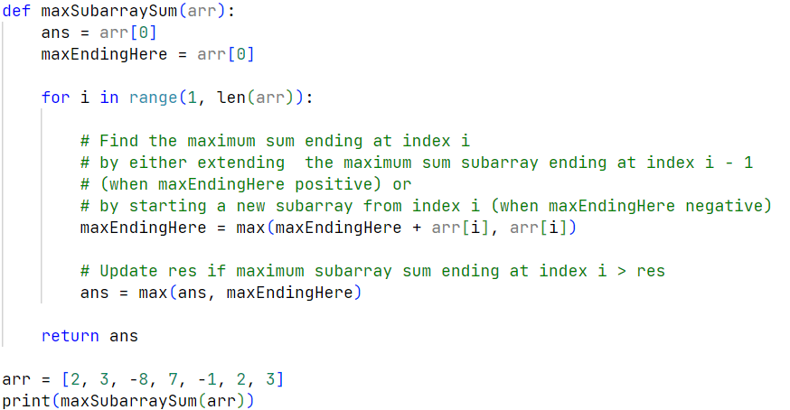
Can we do better?

Slide 20
Practice
-2 | 1 | -3 | 4 | -1 | 2 | 1 | -5 | 4

Slide 21
Resources
CLRS Book:
Chapter 4.1 - The Maximum Subarray Problem
Kadane's Algorithm
Kadane's Algo visualizer

